Slide 1


Python mini-project Topic: Reminder program with notification
2020-21 Sem-II Python Programming

Slide 2
Project Topic: Reminder program with desktop notifications to alert the user
Group members
Name | Roll no. | Part of project
Shreyas Raskar | 16010520087 | Event Reminder
Harsh Khot | 16010520088 | Assignment Reminder
Awwab Khot | 16010520091 | Medicine Reminder
Problem statement:
To design a program which gives reminders in form of Desktop notification: The program should have following reminder functionalities: It should remind about:
A specific event.
Reminder about the user’s medicine schedule.
Pending Assignments.
Sedentary Reminder.

Slide 3
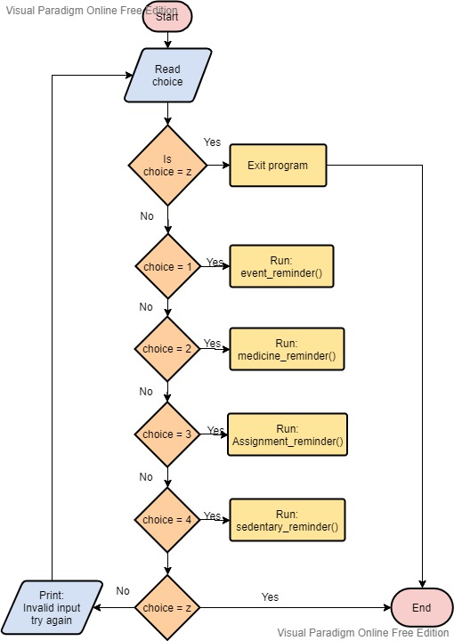
System Architecture:
The main program file is used to combine all the separate code files.
To select the sub-program which user wants to run an else-if ladder is used to move between the choices until the user wants to exit the program.
Each choice calls the respective sub-program functions to run the respective code.
Thus import method is used to call the functions from other python files.

Slide 4
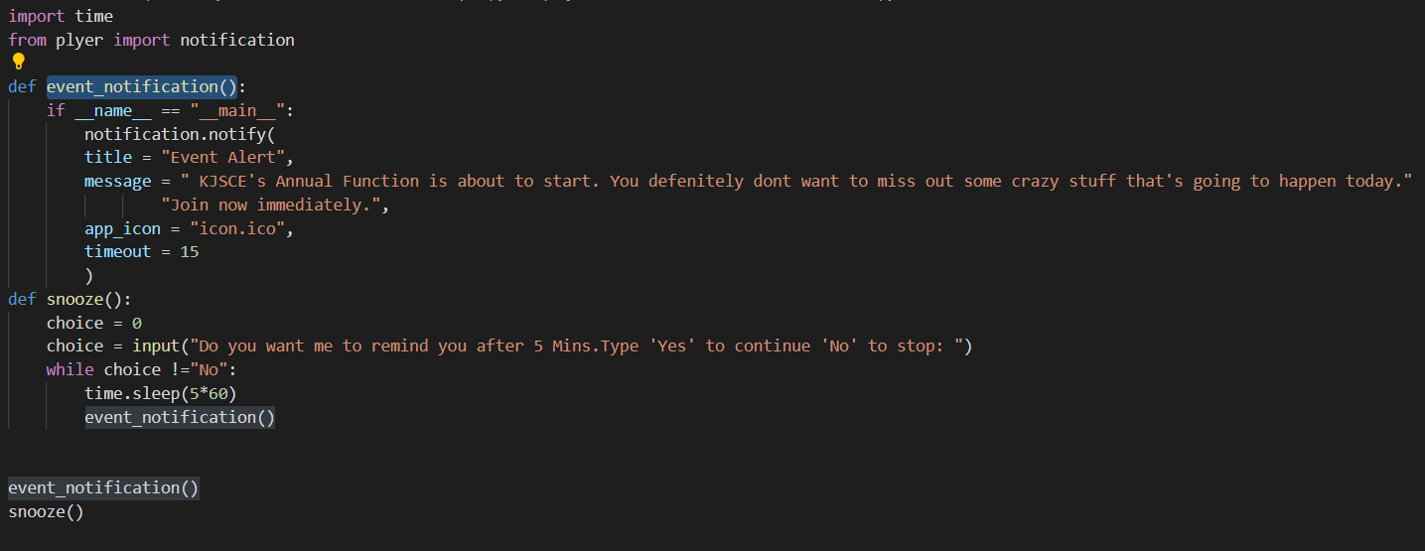
Event reminder program:

Slide 5
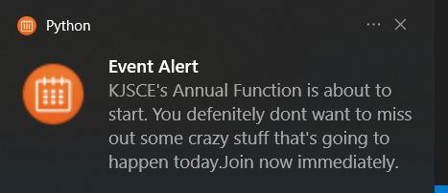
Basic Structure of Program.
The event reminder app gives you desktop notification of the upcoming event and asks you whether to remind you after some time.
The Program is divided in 2 parts:
The event notification alert : Notifies you about an event.
For eg: An online Annual function at your college, the programme is structured in such a way that it gives you a direct notification of the upcoming event on your desktop.
The snooze function : After running the code snooze() Function asks you if you want to run the code after 5 minutes. If you type Yes, program will give you a desktop notification after 5 minutes. If you type No, program exits the app.
5

Slide 6
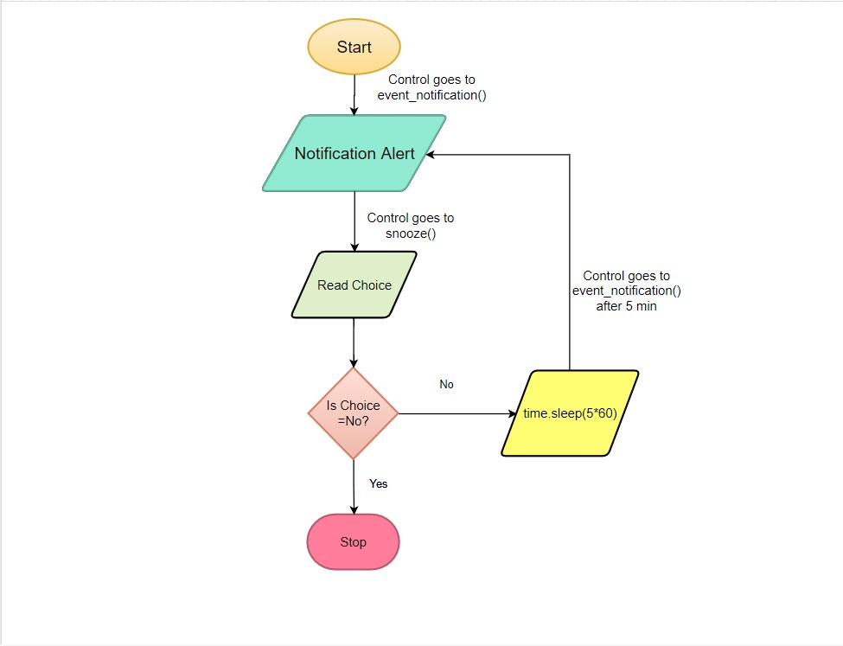
The Flow of the program is as follows:
When run the program the control goes to event_notification() function, in it the notification.notify() function gives you desktop notification about the upcoming event.
Then the program asks you if you would like to be notified again after 5 minutes using input().
If the user says No, the program ends.
If the user says Yes, the program will run again after 5 mins and you will receive a desktop notification again after 5 minutes.
Flow Chart for Event Reminder.
6

Slide 7
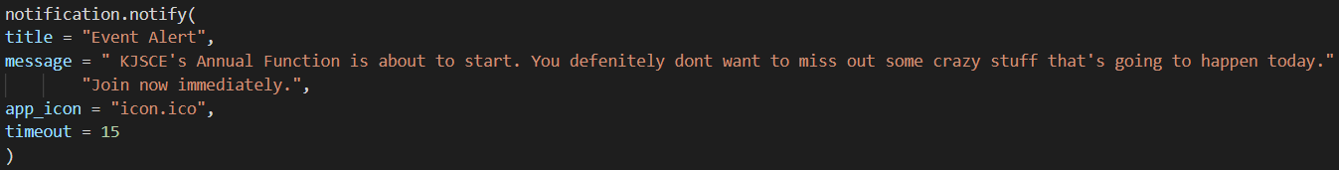
Features of the reminder application program.
The time module:
We have time module to handle time-related tasks. To use functions defined in the module, we need to import the module first using import time .
This helps us using the method time.sleep() to temporarily suspend running the program.
The notification.notify() function:
First we import the notification module from plyer.
Plyer is a python library for accessing features of your hardware/platforms.
First install plyer in python using pip install plyer.
Then using notification.notify() we can create a desktop notification.
Now, there are parameters that needs to be filled in notification.notify() function:
title: Title of the notification
message: Message of the notification
app_icon: Icon to be displayed along with the message
timeout: time to display the message for, defaults to 10
7

Slide 8
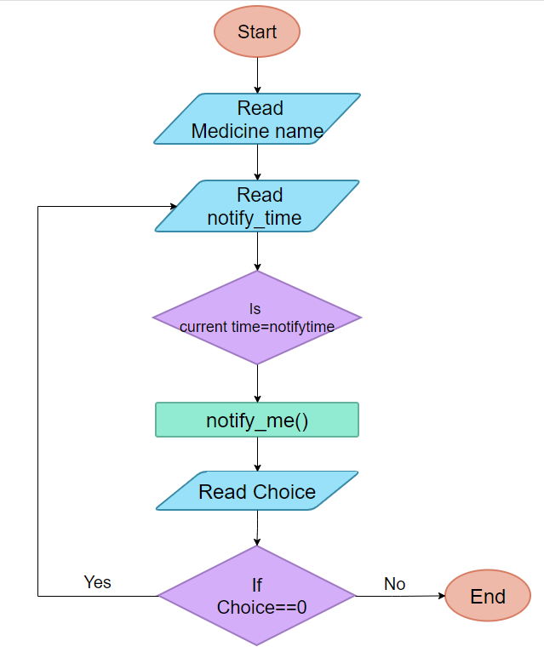
Medicine Reminder:-
In Medicine reminder the program gets input from the user about, the name of the medicine and time to get notification that user wants to get reminded.
A infinite while loop is used and will continue to remind till the user wants to stop the reminder. The plyer module function is used to provide the desktop notification about the reminder.
For executing the first process after a pause choice is there to continue and stop the process
8
8

Slide 9
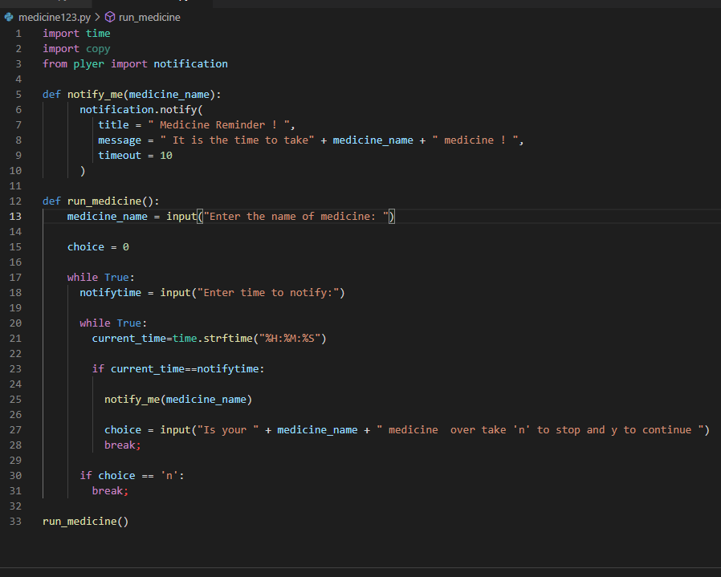
Medicine Reminder code:-
9

Slide 10
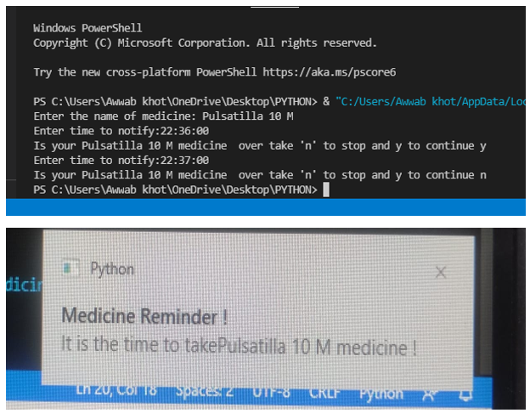
→For getting the output, user must input medicine name and time of notification.
Time should be in 24 hours clock and while entering the time, time should be like this 22:36:00 → (%H:%M:%S ).
Then according to the choice , if you want to continue the program then you should enter y and n to exit.
10

Slide 11
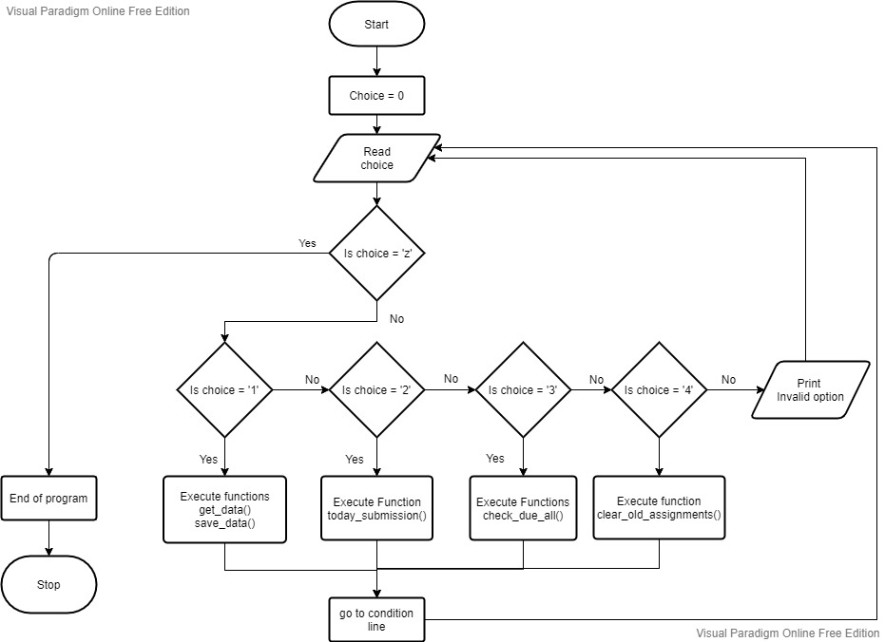
Assignment Reminder:
Main structure:
The sub-program is divided into 4 sub parts.
To get the data about assignments from user and save it in external file.
To show due assignments.
To show assignments which are due today.
To clear overdue assignments.
Use of else-if ladder is used to handle the flow of selection.

Slide 12
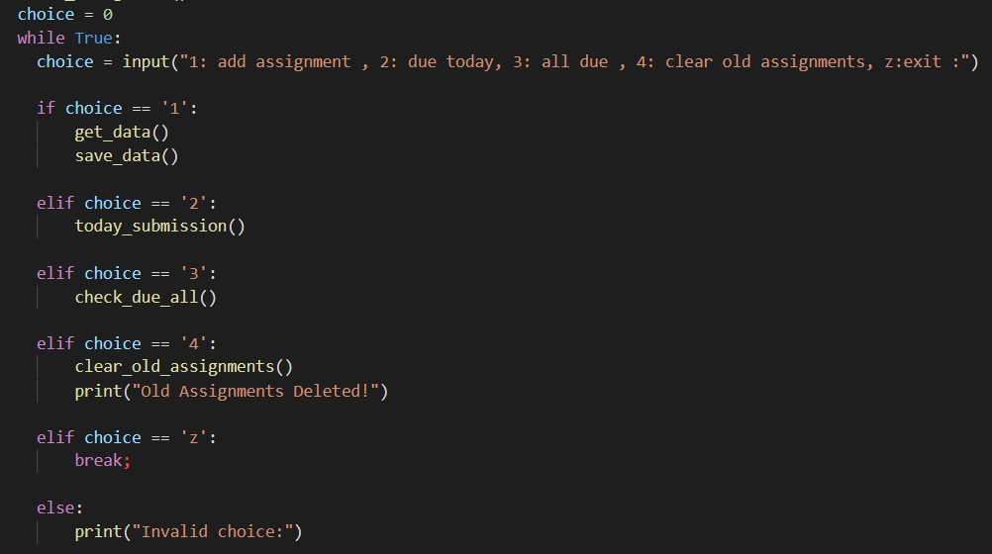

Slide 13
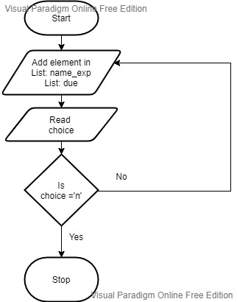
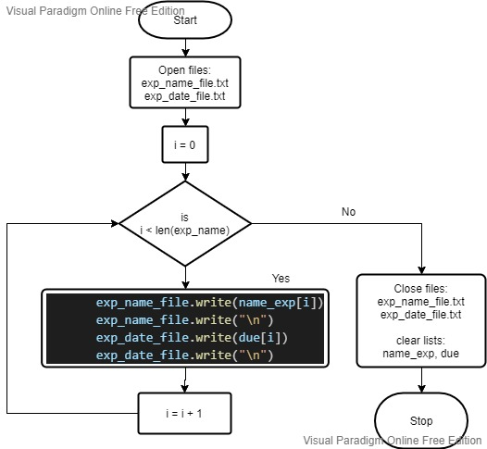
Get Data about assignments:
get_data()
save_data()
To get data from user: Infinite while loop is made to insert element in list till user wants to.
To save data into external file: a pre-written file is opened in append mode and using for-loop data of experiment and their corresponding due dates is stored in two separate files. This is done to ensure that the assignment information remains even after the program is ended.

Slide 14
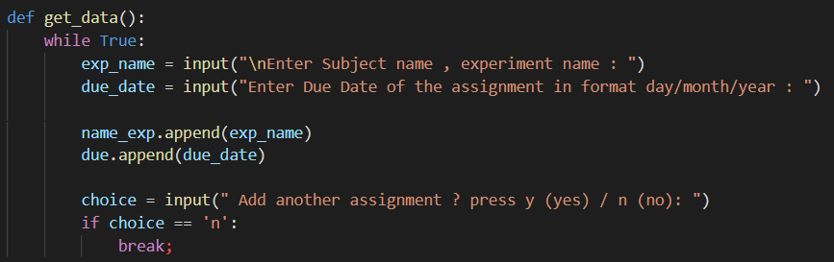
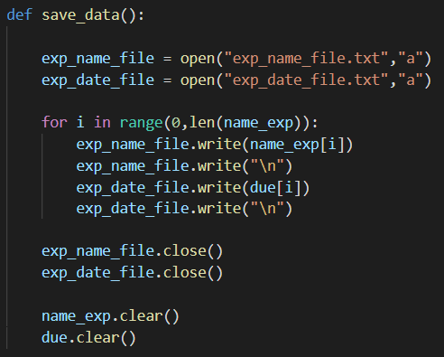

Slide 15
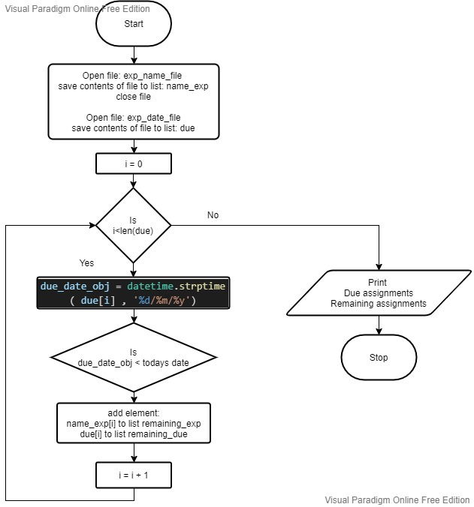
To show all the due assignments:
check_all_due()
first the contents of external files are read and the data is stored in two lists.
Using for loop the due date of each assignment is compared with today’s date and if the date is lesser then the content is stored in other temporary lists.
Note: to compare the dates DateTime module is used and the strings are converted into datetime object before comparing.
Then All the assignments and the overdue assignments are printed in tabular form

Slide 16
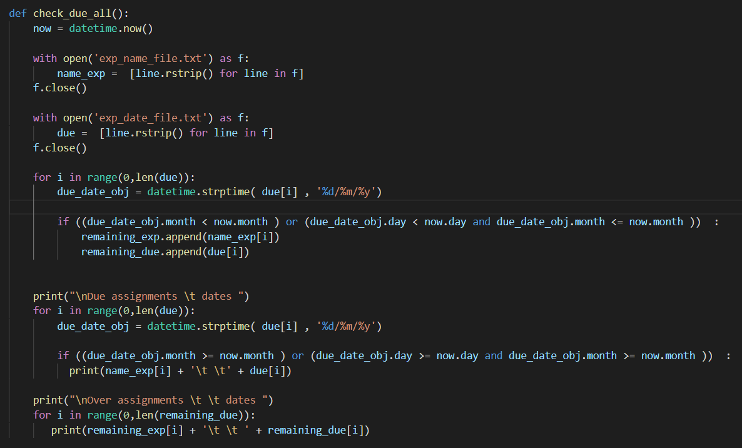

Slide 17
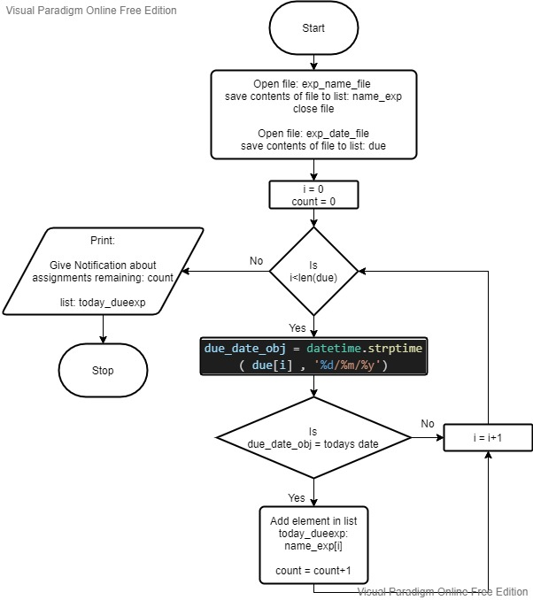
today_submission()
To show assignments due today with notification:
Using for loop the due dates are compared with today’s date and if matched the corresponding experiment names are stored in a temporary array.
Also a counter is incremented to store number of assignment.
Then the array is joined into a string and the names are displayed in the notification with the counter.

Slide 18
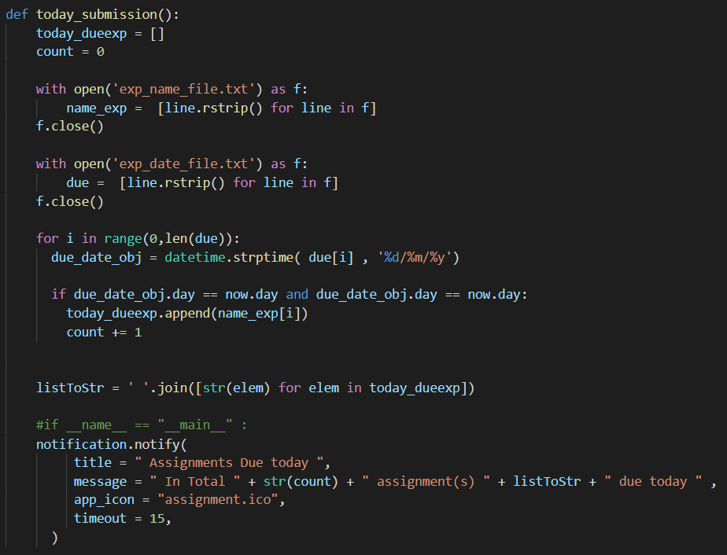

Slide 19
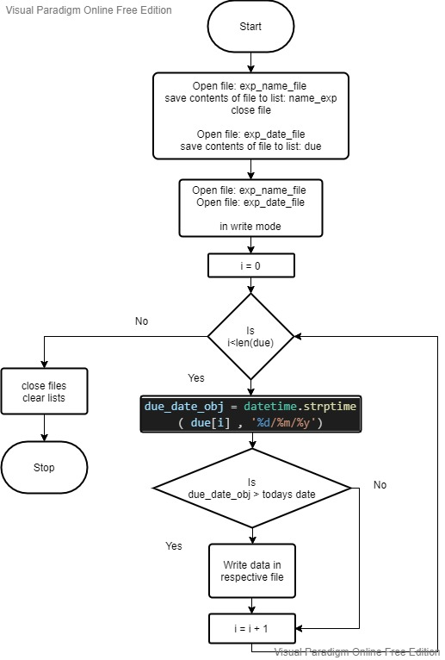
clear_old_assignments()
Clearing overdue assignments:
Here first the data from files is first saved into the two lists. Then the files are opened in write mode thus clearing all the pre-existing data.
Then before storing it in external file the due dates are compared with the current dates and if the date is lesser than the current then the list element for both the list is skipped. Thus in the sense deleting the overdue assignments.
19

Slide 20
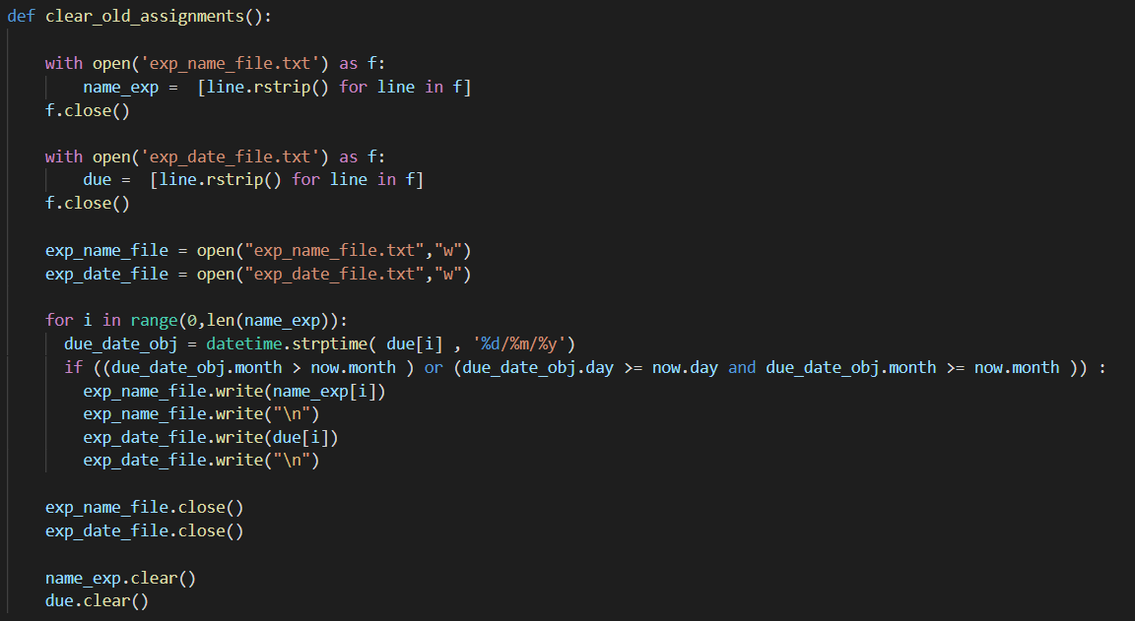

Slide 21
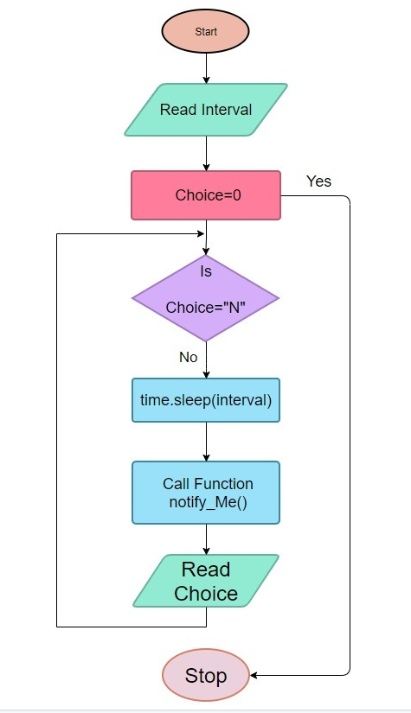
Sedentary Reminder:
Sedentary reminder is used to as a repetitive reminder to do a certain task. In this case this reminder is used to notify user to drink water.
In sedentary reminder the program gets input from the user about the time interval user wants to get reminded.
A infinite while loop is used and will continue to remind till the user wants to stop the reminder. The plyer module function is used to provide the desktop notification about the reminder.
To execute process after a pause time.sleep() function is used to halt the process for the time user has set.
21
21
21

Slide 22



Result:
We were successfully able to implement the use of notifications on desktop using a external python module plyer.
In event reminder concept of time.sleep() was used to schedule the reminder.
In medicine reminder the concept of checking time entered by user with current time using time module built in functions to compare the time and give required output.
In assignment reminder the concept of file handling was used to store the data regarding assignments so that even after the program is closed the data can be used again multiple times.
Conclusion:
Thus In our program we were able to demonstrate the concept of reminders. We were able to give reminders about:
A event.
Your Medicine schedule.
Your Pending assignments.
Drinking water after regular time interval

Slide 23
References:
For assignment reminder
Notification using plyer module https://youtu.be/bTJWRmgPZpE Convert a list to string: https://www.geeksforgeeks.org/python-program-to-convert-a-list-to-string/
Convert string to date, compare date: https://www.educative.io/edpresso/how-to-convert-a-string-to-a-date-in-python
https://www.geeksforgeeks.org/get-current-date-using-python/
For medicine reminder:
https://youtu.be/HHddgUtliBg
https://youtu.be/at7rpdT8FeI
https://youtu.be/aQVdUTJs3yI
For event reminder:
https://medium.com/analytics-vidhya/create-desktop-notifier-using-python-6dab0a1c348c
https://youtu.be/HHddgUtliBg

Slide 24
Thank You

